Slide 1

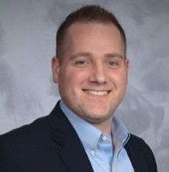
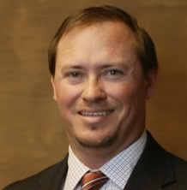
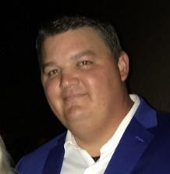
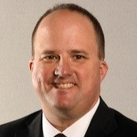
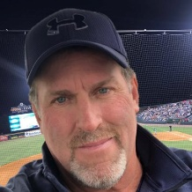

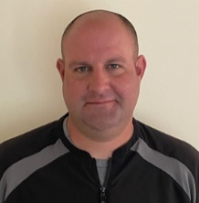
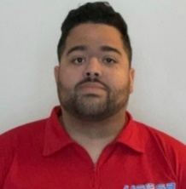
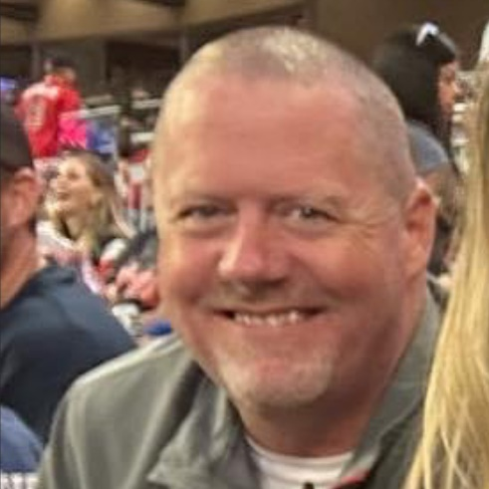
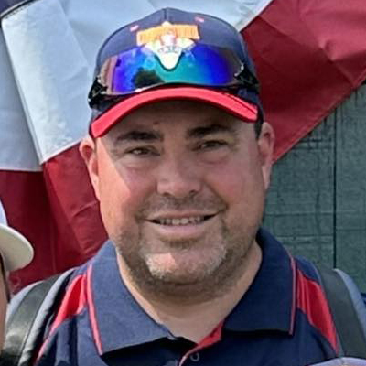
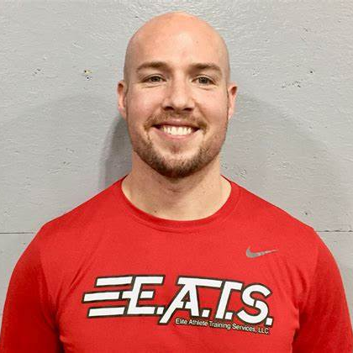
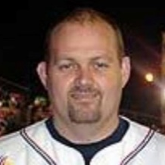
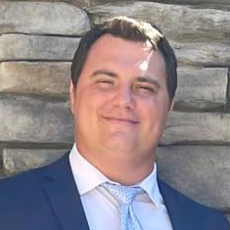
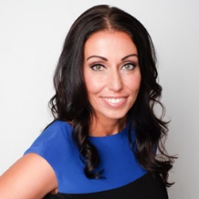
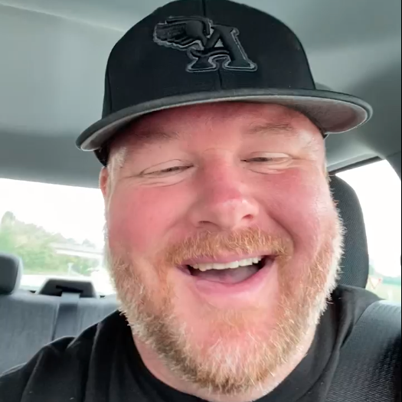
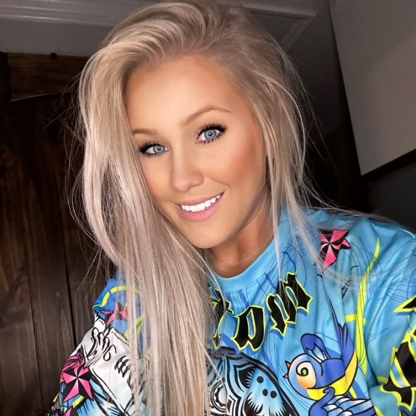

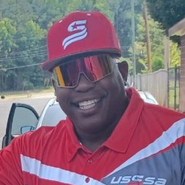
ORGANIZATION HIERACRHY
DOMINICK FERRARO
MANAGING MEMBER
ALB, LLC
CHRIS WELLS
MANAGING MEMBER
WK SPORTS, LLC
USSSA specialty events & operations, overseeing the Charlotte and NOVA Markets, Showcase, Contracts, Relationships & Technology.
ANDY KING
MANAGING MEMBER
ALL OUT ATHLETICS, LLC
Overseeing the Upstate of SC and Western, NC.
Financial & Budget Management.
Operations for the Triangle, NC. Event Purchasing
and Social Media .
STUART LAKE
DIRECTOR (SHOWCASE)
COMPANY WIDE
TODD MILLER
AREA DIRECTOR
UPSTATE, SOUTH CAROLINA
RAY BRINCEFIELD
AREA DIRECTOR (13u to 18u)
TRIANGLE, NORTH CAROLINA
Director of Operations for Prospect Showcase.
Area Director, Weekend Scheduling, Staffing & Team Communication for the Upstate of SC.
Area Director and Staffing for Triangle NC.
JASON TERRY
AREA DIRECTOR (BASEBALL)
CHARLOTTE, NORTH CAROLINA
KENDAL STONE
AREA DIRECTOR (BASEBALL)
CHARLOTTE, NORTH CAROLINA
CHAD MICHEALS
AREA DIRECTOR & UIC
WESTERN, NORTH CAROLINA
KEVIN STOCKWELL
SOCIAL MEDIA DIRECTOR
COMPANY WIDE
Area Director and Staffing for Charlotte, NC.
Area Director, Scheduling for Charlotte, The Triad, The Triangle, NC and Northern, VA.
Area Director, Weekend Scheduling, Staffing, Team Communication and UIC for Western, NC.
Responsible for all Social Media for the Company.
JOHNNY WITHROW
DIRECTOR OF BASEBALL OPS
NORTHERN, VA
COLIN QUAY
AREA DIRECTOR
NORTHERN, VA
BUBBA SMITH
AREA DIRECTOR
TRIAD, NORTH CAROLINA
TREY THOMPSON
INTERM AREA DIRECTOR & UIC
TRIANGLE, NC
Area Director, Scheduling, Staffing for
Northern, VA.
Area Director, Scheduling, Staffing for
Northern, VA.
Area Director, Staffing, Team Communication
for Triad, NC.
Area Director, Scheduling, Staffing for the Triangle. Assigns all Umpires in the Triangle.
NICOLE LIGRECI
ACCOUNTING
NC, SC & VA Company Wide
BRANDON ROBERTS
AREA DIRECTOR (SOFTBALL)
STATE OF NORTH CAROLINA
STEPHIANE GALANT
DIRECTOR (SOFTBALL)
STATE OF NORTH CAROLINA
Quick Books Administrator, Banking, Billing, Umpire 1099 forms and Event Distribution.
Director of Operations, Scheduling, Team Communication Staffing for North Carolina Softball.
Director for North Carolina Softball.
JOHNNY HUMPHRIES
UMPIRE IN CHARGE
UPSTATE, SOUTH CAROLINA
JAMES GRIFFIN
UMPIRE IN CHARGE
CHARLOTTE & TRIAD, NC
DANNIE EDWARDS
UMPIRE IN CHARGE
NORTHERN, VIRGINA
Assigns all Umpires for the Upstate Market
in South Carolina.
Assigns all Umpires for the Charlotte and Triad Market in North Carolina for Baseball & Softball.
Assigns all Umpires for the Northern VA Market.
Notes:
Easily change photo. Please click on the small icon in the center of the holder and choose an image on your computer.

Slide 2

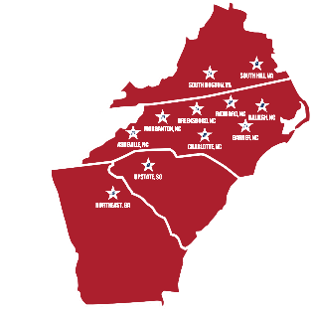





SOFTWARE & REVENUE FLOW CHART
ALL LEAGUE
ALB.USSSA.COM
Youth baseball tournaments
for ages 7u to 18u in SC, NC & VA. Additional revenue from hotels and merchandise.
PROSPECTSHOWCASE.COM
Showcase tournaments for 13u to 18u. Additional revenue from hotels, merchandise & the components of GameDay.
GAMEDAY.CENTER
White label solution for organization & teams to run
their business.
UMPIRE/REFEREE.CENTER
Centralized location for
assigning umpires and referees with membership fees.
GAMEDAY CENTER
TEAMSTAT.CENTER
Similar, but identical to Game Changer. This will exist and track stats and data throughout all of platforms.
TRAVELTEAM.STORE
From gear to apparel to uniforms design. Team and Organizations can have their own shop. Like turn2apparel.com.
COLLEGEPLANNING.CENTER
One stop shop for college planning and recruiting. Everything from SAT and ACT prep, to college searching to career assessments.
TRAVELBASEBALL.TEAM
Teams & organizations retain their own website with their color scheme and brand. With a full admin panel for all their business needs, profiles & more.
GAMEDAY.SOCIAL
Teams and organizations Publish & manage your player's or team's sports images, videos & events to all your social media networks with one click!
Notes:
Easily change photo. Please click on the small icon in the center of the holder and choose an image on your computer.

