Slide 1
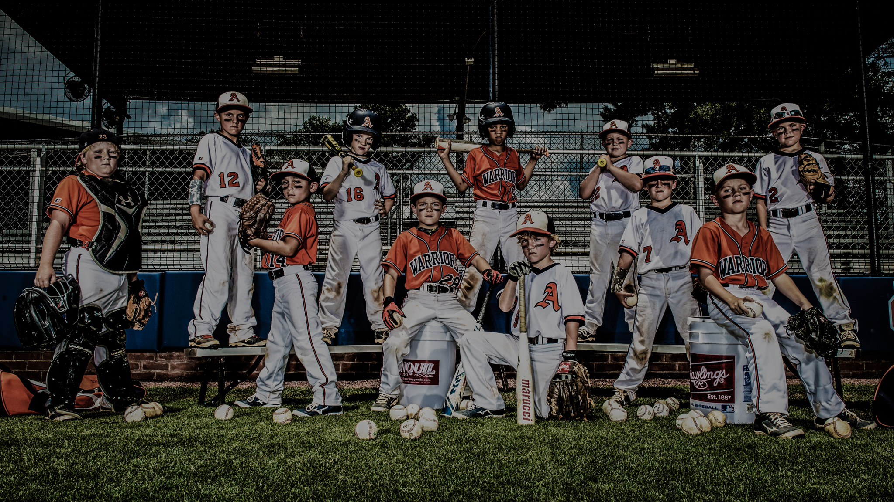


ECONOMIC IMPACT, GROWTH AND DEVELOPMENT
INFO@ALLLEAGUEBASEBALL.COM
ALL LEAGUE BASEBALL POWERED BY USSSA
2024

Slide 2

2024
Executive Summary
The economic impact from All League Baseball (USSSA) two-day tournaments extended beyond local teams, with visiting participants
and their guests contributing $33.1 million in 2023 through spending on hotels, restaurants, and other activities.
2024 is shaping up to be a banner year, with a projected growth of 37%!
In 2023, we hosted 648 of our 9,237 teams in and around the Cary and Raliegh market with limited field space.
40% (259) of these 648 teams traveled from out-of-town and 60% (389) of them where consider local.
All League Baseball (USSSA) was still able to produce an economic impact of $2.7 million in the Triangle.
Sources: Docking Institute of Public Affairs, South Carolina Department of Parks, Recreation & Tourism, Clemson University Department of Parks, Recreation and Tourism Management,
University of Florida - Economics Department, World Travel & Tourism Council and U.S. Energy Information Administration (EIA)
INFO@ALLLEAGUEBASEBALL.COM

Slide 3

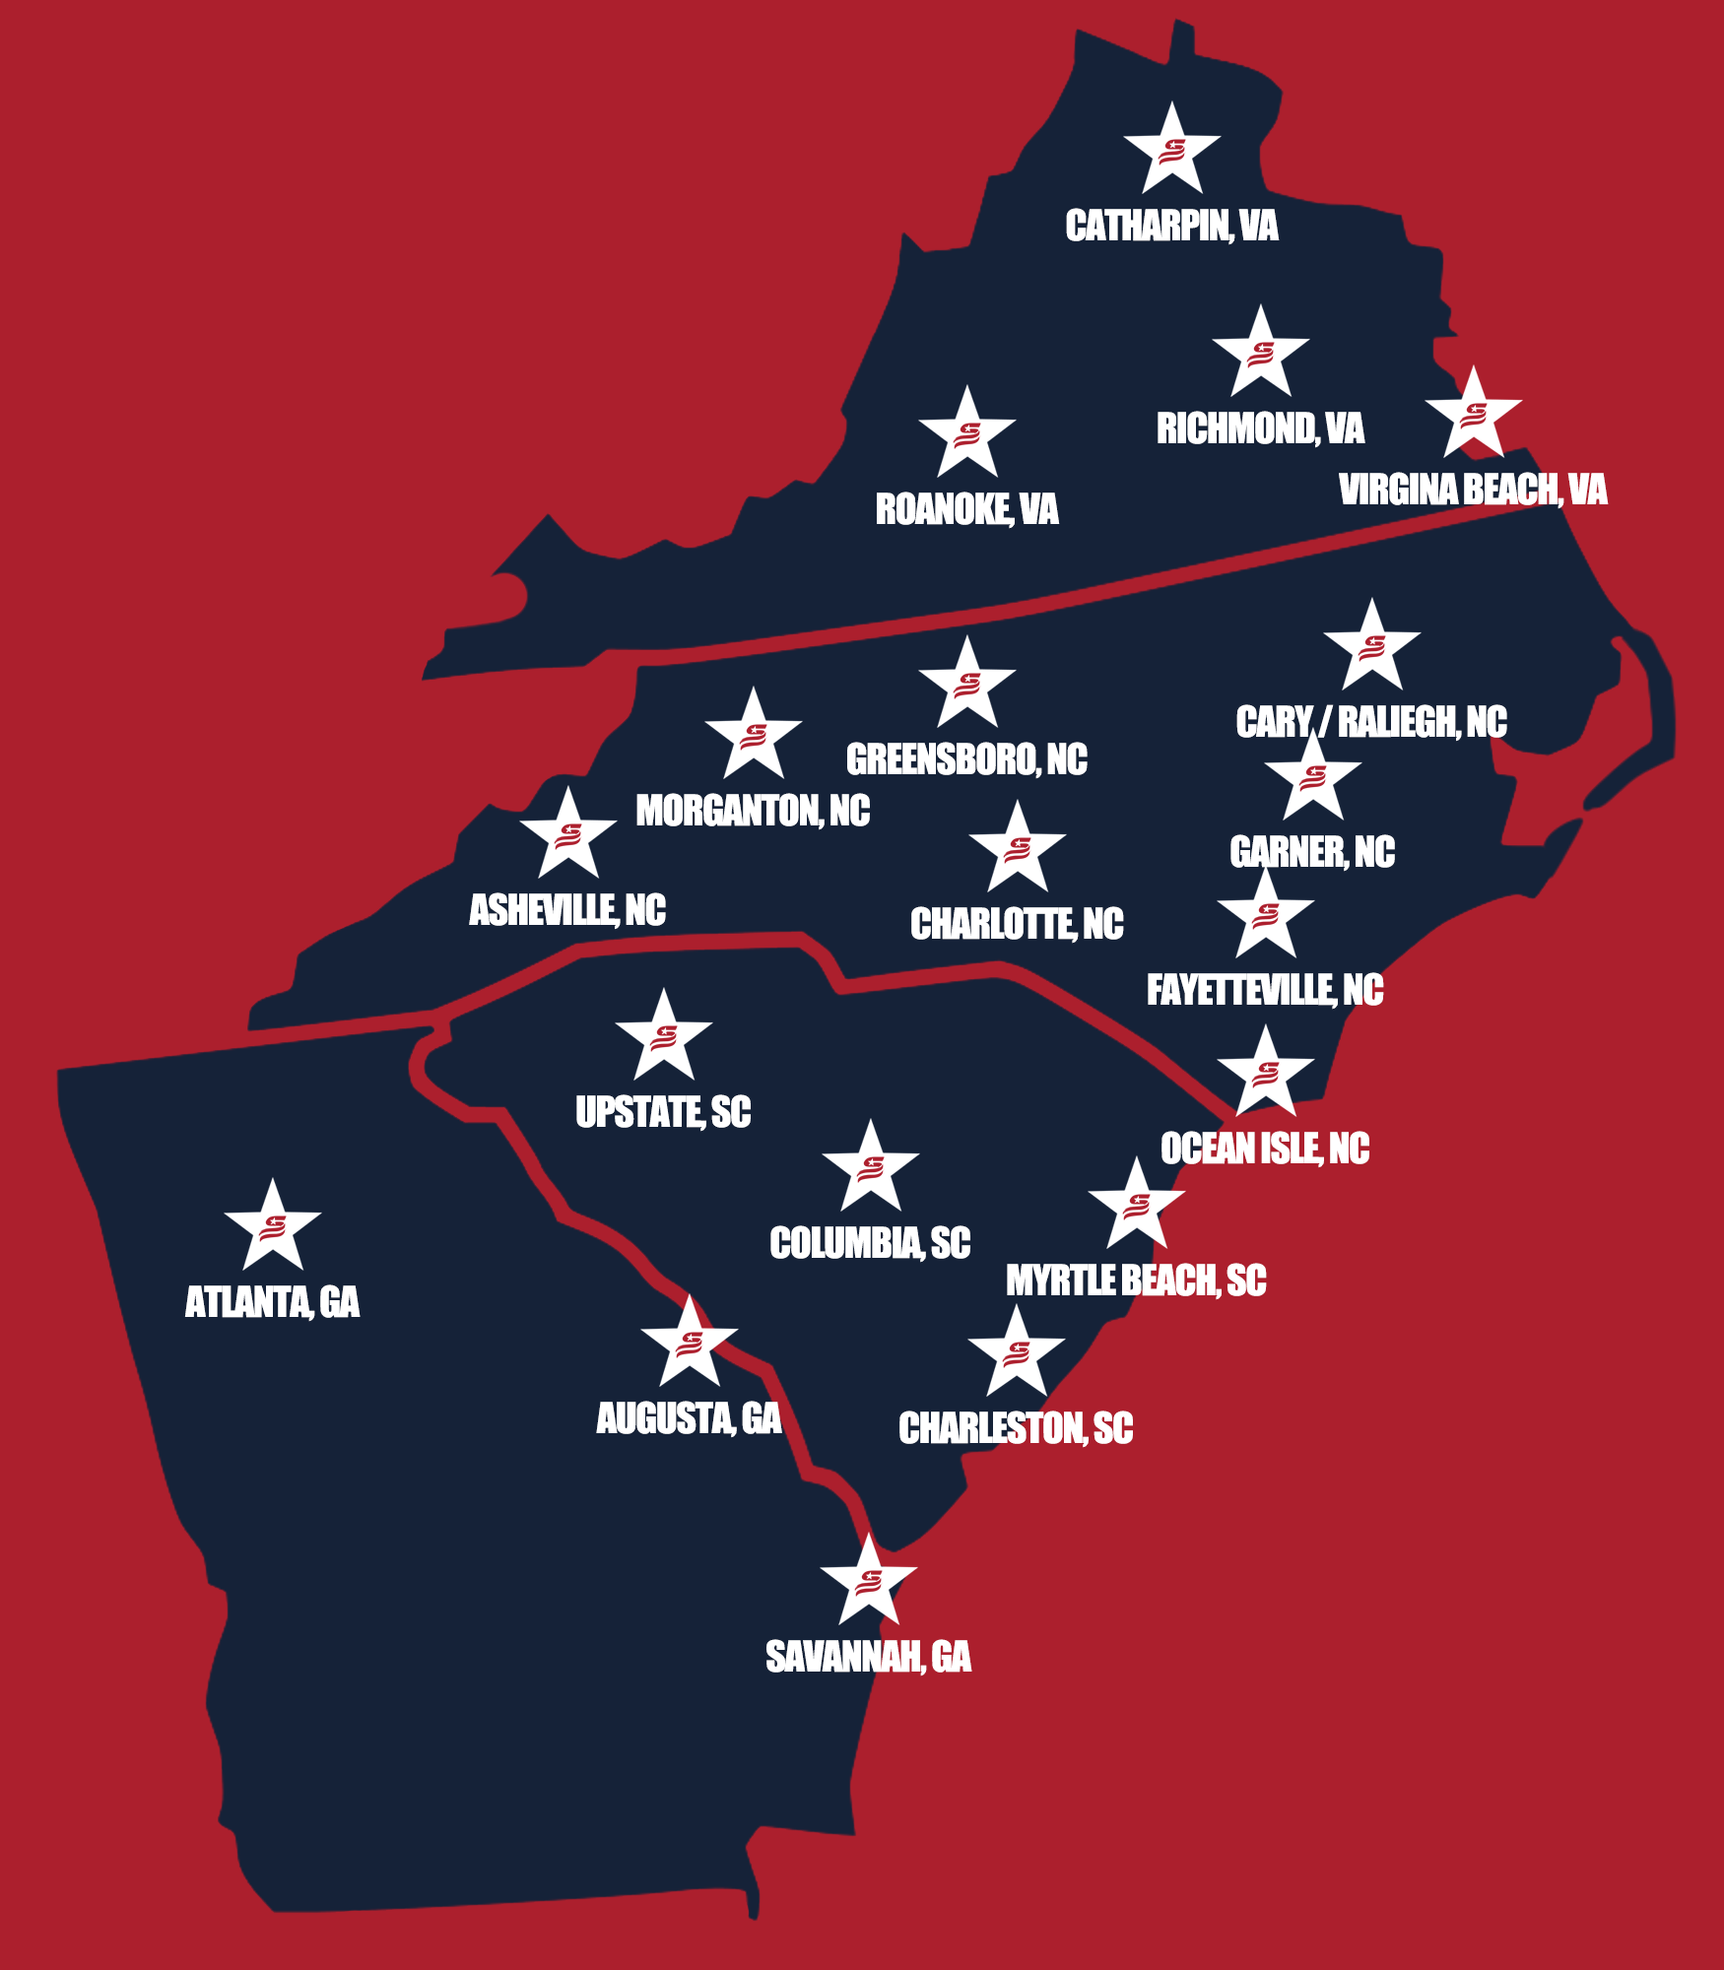


TEAMS TRAVEL FROM THESE AREAS &
SURROUNDING
LOCATIONS & FOOTPRINT
INFO@ALLLEAGUEBASEBALL.COM
USSSA BASEBALL NATIONALLY
With over 70,000 registered teams and 840,000+ participating families nationwide, our national brand recognition has enabled us to achieve remarkable results.
ALL LEAGUE BASEBALL
With a presence in 4 different states, we hosted 9,237 registered teams in 2023.
Non-National Events (191 Tournaments and 7260 teams over 6 locations): 21% (1,524) of these teams were considered out of town.
National Events (19 Tournaments and 1977 teams over 6 locations): 38% (751) of the teams were from out of town.
2024

Slide 4
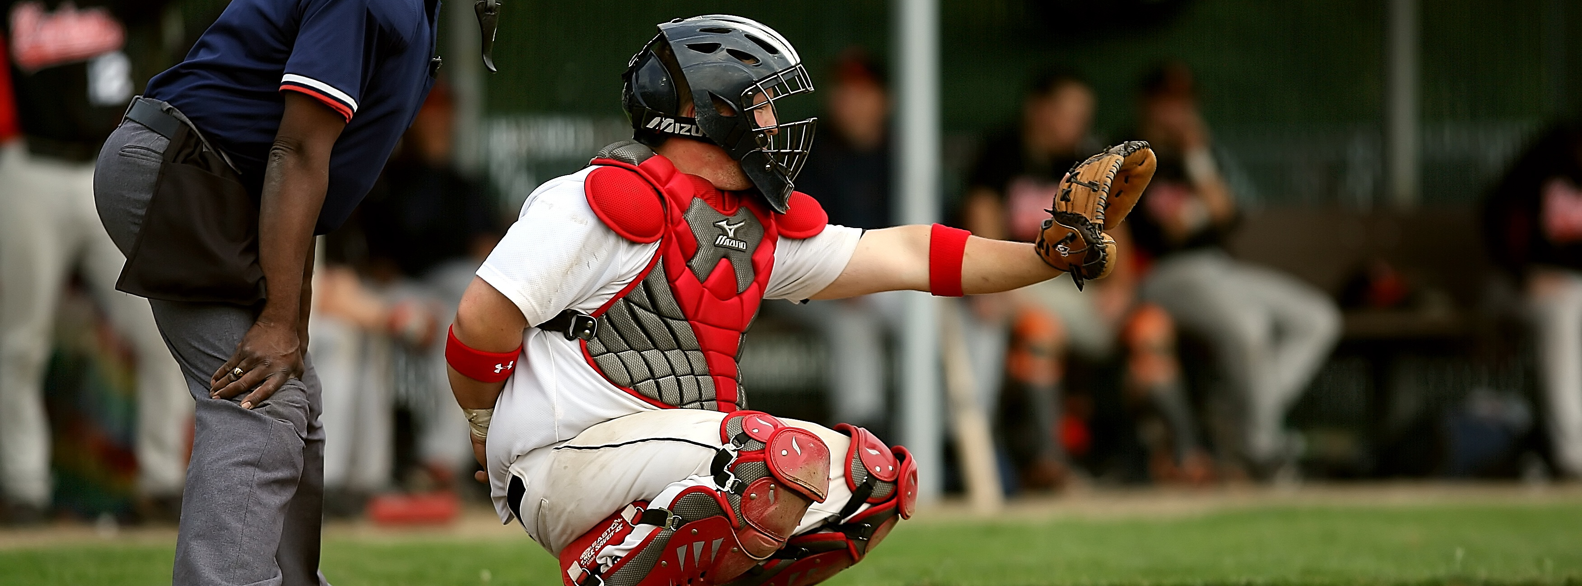
NATIONAL &
NON-NATIONAL
2024
TEAMS TRAVELS
SPENDING
PROJECTIONS
Each out-of-town visitor/spectator is projected to spend on average $245.20 per weekend while local spectators that commute to and from the tournament average $92.81 in spending per weekend.
TOURNAMENTS & EVENTS
Lodging
$28.80 - $75.00
Groceries
$7.28 - $20.00
Restaurants
$20.86 - $40.00
Shopping
$10.58 - $50.00
Fuel
$19.68 - $35.20
Entertainment
$5.61 - $25.00

Slide 5
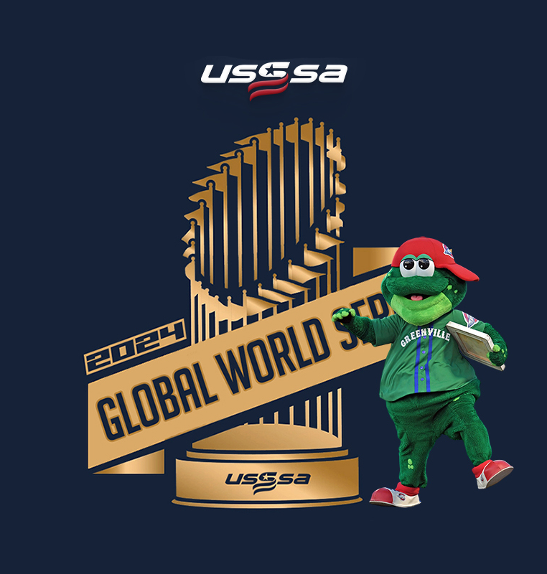


National Events
These are just some of the National Events we run that we can bring to the Cary and Raleigh Market.
INFO@ALLLEAGUEBASEBALL.COM
NATIONAL EVENTS
USSSA GLOBAL WORLD SERIES
UNDER ARMOUR CHAMPIONSHIP SERIES
ASG24 ALL-STATE GAMES
7500+ SPECTATORS 4 DAYTOURNAMENT
50% OUT-OF-TOWN
4200+ SPECTATORS
3 DAY TOURNAMENT
45% OUT-OF-TOWN
3900+ SPECTATORS
3 DAY TOURNAMENT
70% OUT-OF-TOWN
2024

Slide 6

NATIONAL INVITATIONAL
INFO@ALLLEAGUEBASEBALL.COM
TOURNAMENTS
Our Super Select NITS and NITS are some of the biggest events in the country. All league Baseball runs 12 of them annually. 2 in each location.
Each Super NIT averages 185 teams per tournament. That’s over 10,175 spectators with 35% of the teams from out of the area. That’s an economic impact of $740k in just two events.
2024

Slide 7
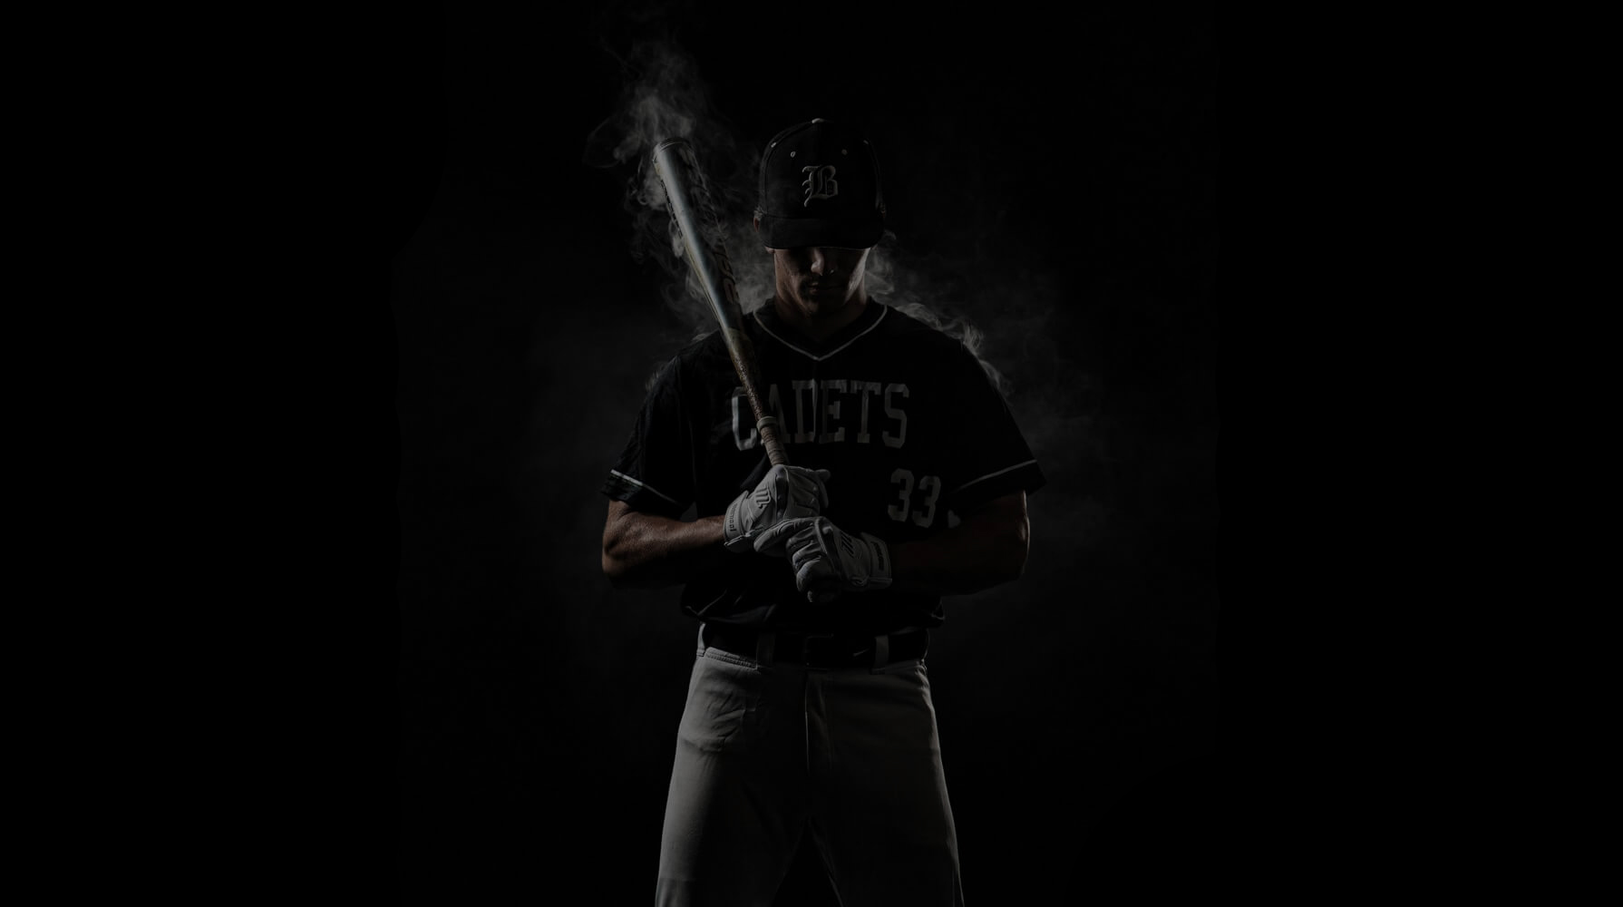
INFO@ALLLEAGUEBASEBALL.COM
2024

